Slide 1
Patient Triage System for Emergency Care Using Clustering
Group 3
Adithya A
Aswathi V K
Komal Dadarao Ghatol
Madhavi Prasad
Majjiga ReddyRani
Muhammed Shanaf P

Slide 2
Contents
Introduction
About the Data
Objective of the Study
EDA
Model Building & Evaluation
Model Deployment
Challenges Faced During the Project
Overcame the Challenges
Conclusion

Slide 3

INTRODUCTION
In emergency medical situations, accurate and quick patient prioritization is crucial for effective treatment. Manual triage systems often face delays, leading to mismanagement of critical patients. This project aims to build an automated system that can categorize patients based on their symptoms and vitals to help healthcare professionals prioritize patients in real time.

Slide 4
ABOUT THE DATA
Data with Risk factors, Characters, Living area etc of patients including Age, Gender, Chest pain type, Blood pressure, Cholesterol level, Maximum heart rate, Exercise Angina, Plasma glucose, Skin thickness, Insulin level, BMI, Diabetes Pedigree function, Hyper tension, Heart disease, Smoking status, Residence.

Slide 5
OBJECTIVE OF THE STUDY
Based on patient symptoms, identify patients
needing immediate resuscitation, to assign
patients to a pre-designated patient care area,
thereby prioritizing their care; and to initiate
diagnostic or therapeutic measures as
appropriate.

Slide 6
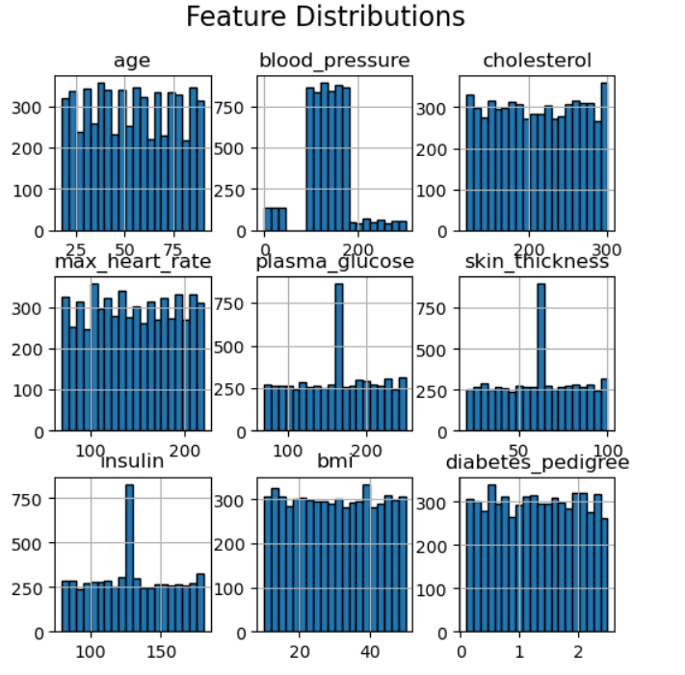
EDA
Distribution Of Numerical features
Histogram Plot: Visualize the distribution of key medical features to understand the underlying data patterns.
Observations:
Blood Pressure & Cholesterol show a normal distribution, indicating stable patterns in patients.
Plasma Glucose & Insulin have skewed distributions with spikes, indicating possible outliers or diabetic patients.
BMI & Diabetes Pedigree Function show uniform distribution, indicating diverse patient samples.
Max Heart Rate & Age are evenly distributed, which is essential for accurate clustering.

Slide 7
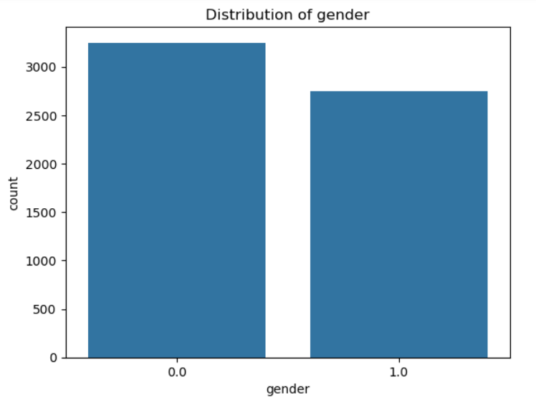
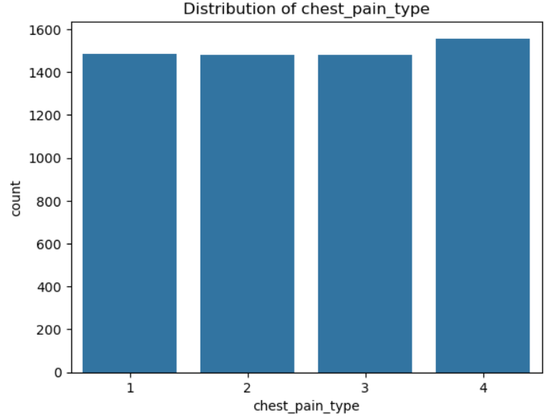
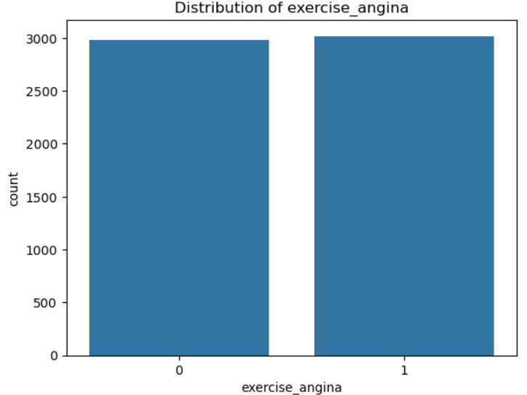
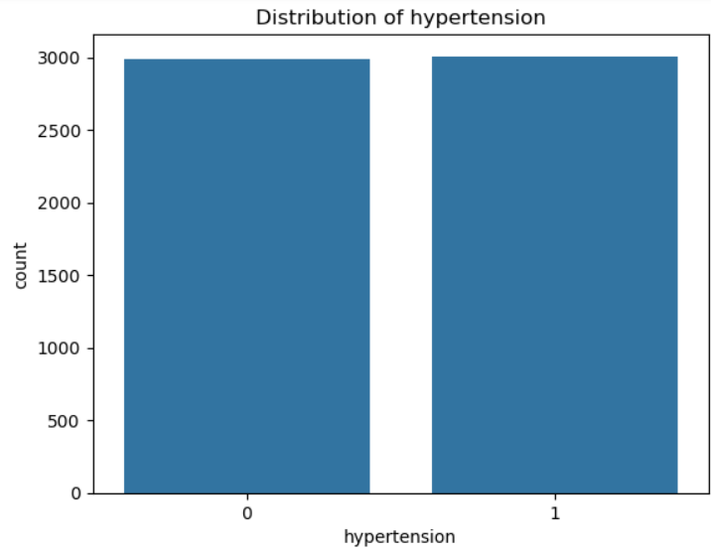
Distribution of Categorical features

Slide 8
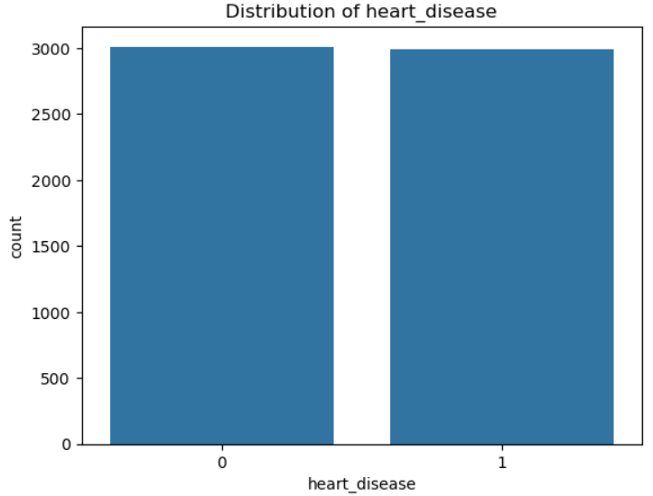
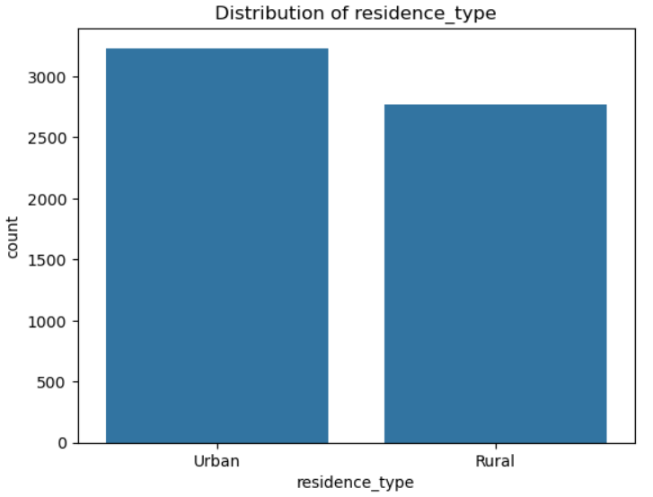
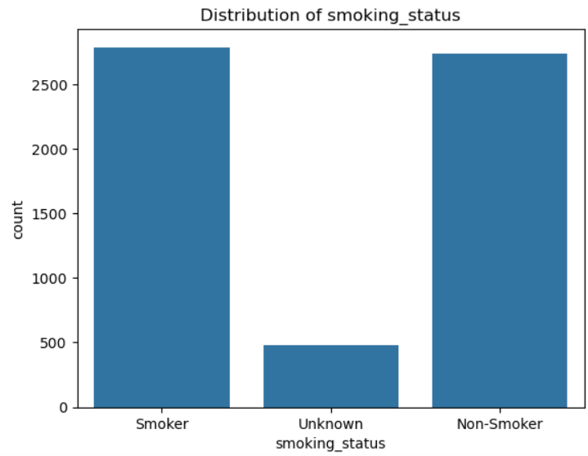
There is a higher number of patients from urban areas compared to rural areas. This could be due to the availability of healthcare facilities and population density in urban areas.
The majority of patients are either smokers or non-smokers, while a small portion has an unknown smoking status. The "Unknown" category could be due to missing data or patient non-disclosure.

Slide 9
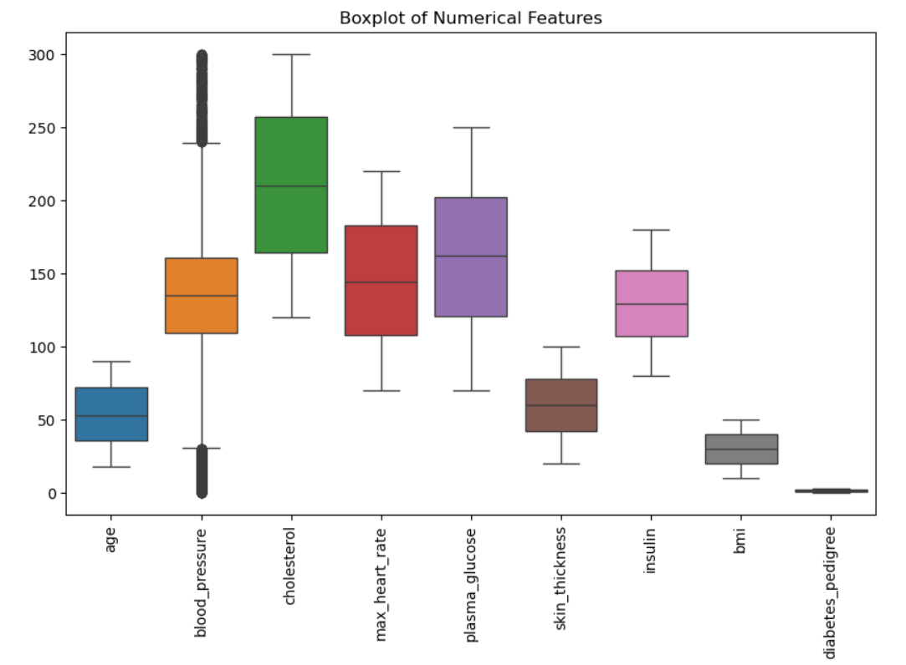
Boxplot
Presence of Outliers: Blood pressure and cholesterol levels show significant outliers. The dots outside the whiskers indicate extreme values that deviate from the normal range.
Variation Across
Features like cholesterol, plasma glucose, and max heart rate have a wide range of values, indicating high variability.
On the other hand, diabetes pedigree and BMI have a more concentrated range.
Median and Quartile Distribution:
The median line inside each box shows the central tendency.
plasma glucose has a higher median compared to other features.
The spread of blood pressure and cholesterol indicates that these features have variation.
Skewness:
If the median line is closer to the bottom or top of the box, it suggests skewness.
For example, insulin appears to have a positive skew (median closer to the bottom).
Potential Data Imbalance:
Some features like skin thickness and diabetes pedigree have relatively narrow interquartile ranges, suggesting limited variance.

Slide 10
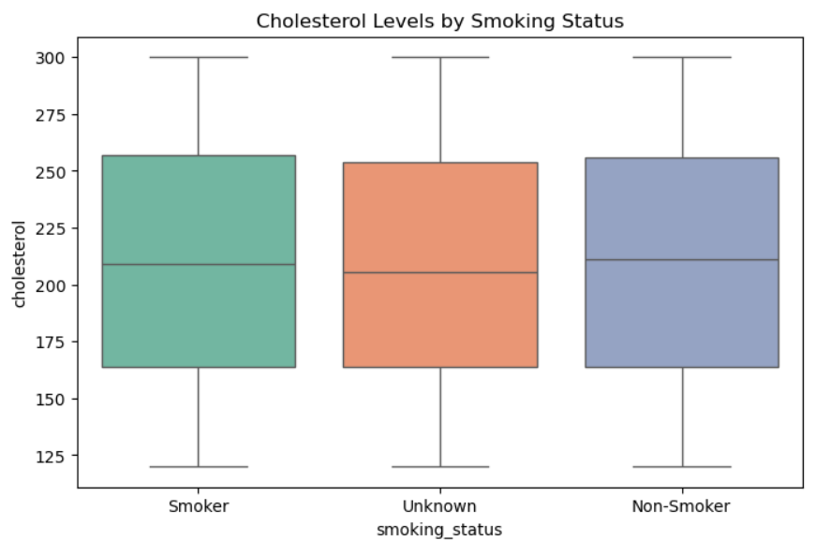
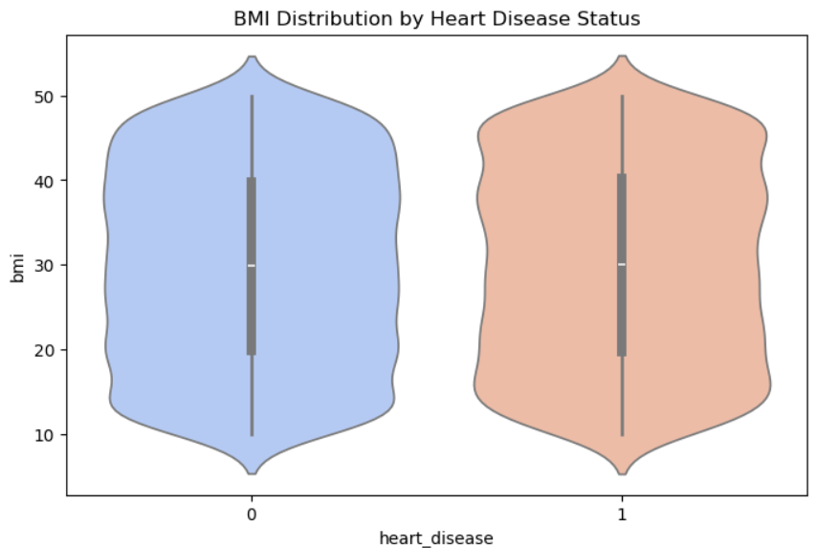
Bivariate Analysis
Cholesterol Levels by Smoking Status (Box-plot):
The median cholesterol levels appear similar across Smokers, Non-Smokers, and those with Unknown status.
Smokers seem to have a slightly wider inter-quartile range (IQR), indicating more variability in cholesterol levels.
BMI Distribution by Heart Disease Status (Violin Plot):
The BMI distribution for individuals with and without heart disease looks similar, with a slightly higher concentration in the 25-35 BMI range.
Individuals with heart disease seem to have a slightly higher BMI range compared to those without heart disease.

Slide 11
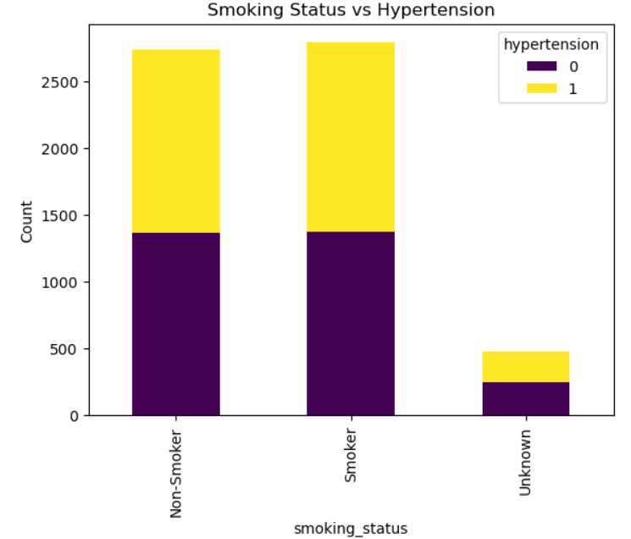
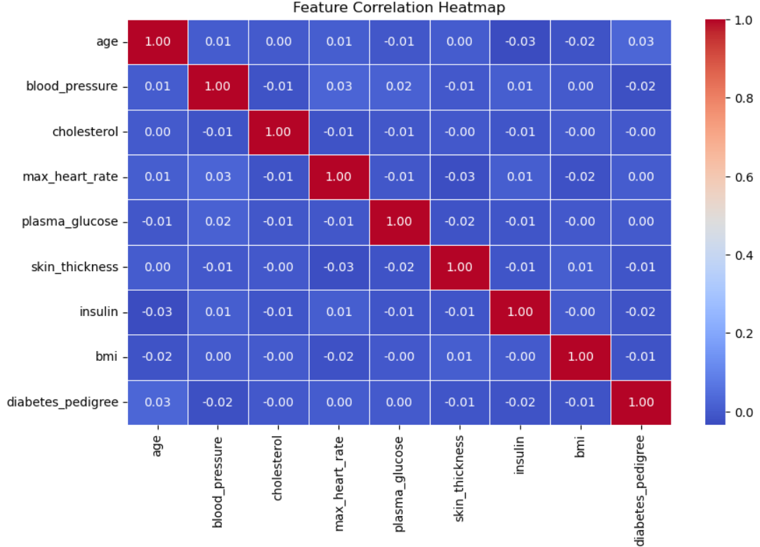
Smoking Status vs Hypertension (Stacked Bar Plot):
A higher proportion of Smokers have hypertension compared to Non-Smokers.
The Unknown smoking status group has fewer samples, but there is still a notable proportion with hypertension.
No strong correlations exist between any of the features, as most correlation values are very close to 0. The diagonal values are 1, which indicates the correlation of a feature with itself. A few features show slight positive or negative correlations, but they are very weak (e.g., age and diabetes pedigree show a correlation of 0.03, which is negligible). This suggests that the dataset might not have multicollinearity issues, but the lack of strong correlation could also indicate that the features might not be linearly related.

Slide 12
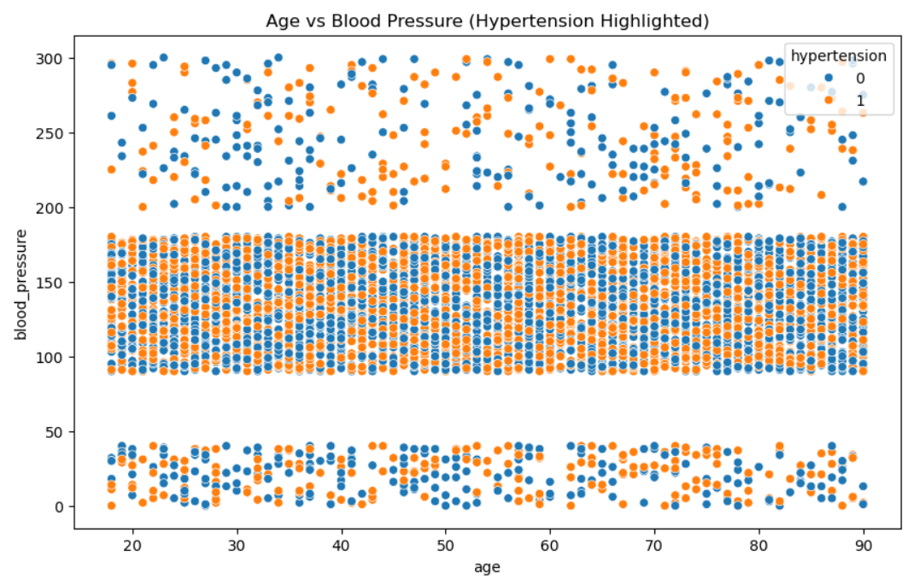
Hypertension Patterns:
Orange dots represent individuals with hypertension, while blue dots represent those without.
Individuals with higher blood pressure levels tend to have hypertension, which is expected.
Age Distribution:
Across all age groups, there is a higher density of blood pressure readings between 100-200, regardless of hypertension status.
However, individuals with extremely high blood pressure (above 200) are more likely to have hypertension.
Blood Pressure Clusters:
There are three distinct bands of blood pressure:
Low (0-50): Mostly non-hypertensive individuals.
Normal (100-200): Mixed distribution of both hypertensive and non-hypertensive individuals.
High (200-300): Dominated by hypertensive individuals.
Age Factor:
Age does not show a strong correlation with blood pressure, as hypertensive individuals exist across all age groups.

Slide 13
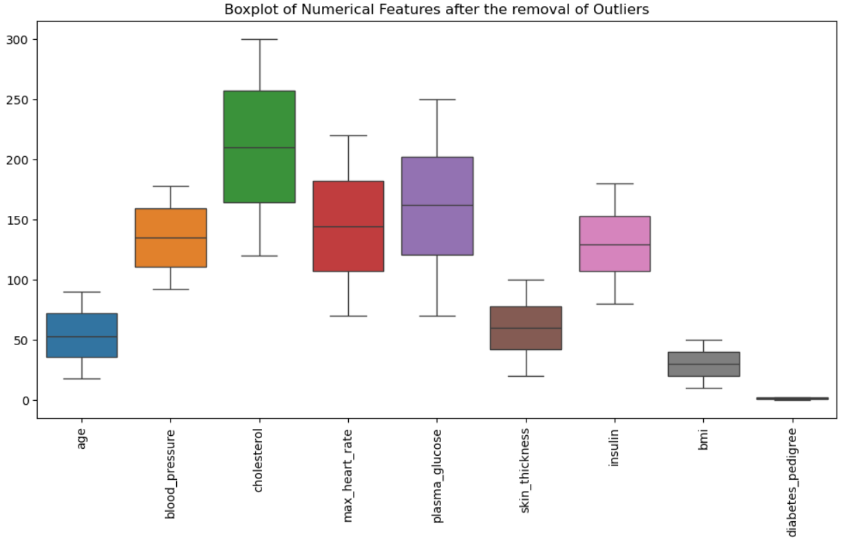
Boxplot of numerical features after the removal of outliers
Handled skewed distributions and removed outliers,

Slide 14
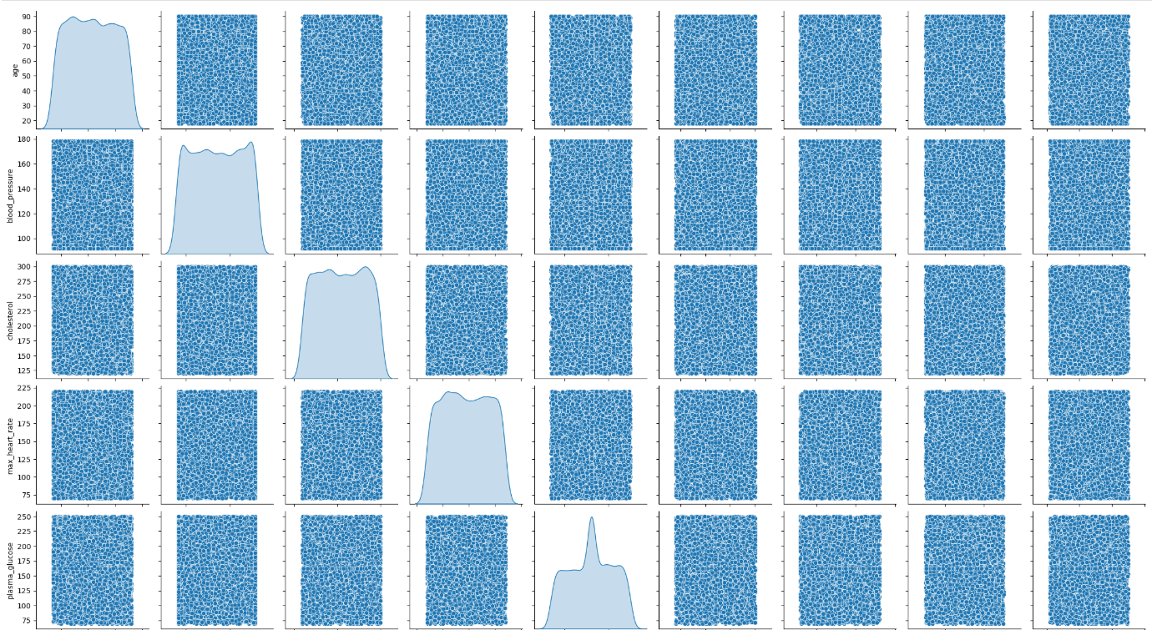
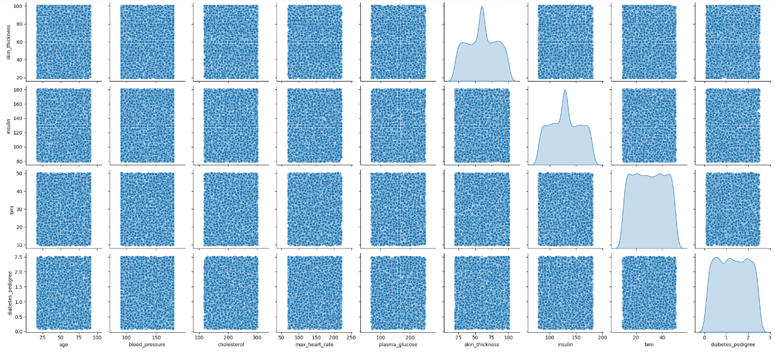
Pair Plot
No Strong Correlation:
The scatter plots between the features seem randomly distributed, indicating no strong linear correlation between most features.
Distribution of Individual
Features:
The diagonal plots show the distribution (KDE plots) of each feature. Some features like plasma glucose and cholesterol have right-skewed distributions, while others like BMI and blood pressure seem more normally distributed.

Slide 15
MODEL BUILDING & EVALUATION
Clustering is an unsupervised machine learning technique used to group similar data points based on patterns and similarities without any labeled output.
In the model building phase, the goal is to identify hidden patterns and structures in the data by forming meaningful clusters.
Popular Clustering Algorithms
K-Means Clustering
2) Hierarchical Clustering
3) DBSCAN (Density-Based Spatial Clustering)

Slide 16
Evaluation after performing PCA and hyper parameter tuning in K means, Hierarchical and DBSCAN Clustering.
Model | Silhouette Score | Davies-Bouldin Index | Calinski-Harabasz Score
K-Means | 0.474394 | 0.704915 | 5614.180161
Hierarchical | 0.535007 | 0.510407 | 1379.907386
DBSCAN | 0.547188 | 0.623635 | 2738.061669

Slide 17
Model Selection
Hierarchical Selected since it has,
Best Silhouette Score (0.535) – indicating well
separated clusters
Lowest Davies-Bouldin Index (0.510) – meaning more
compact, distinct clusters
Moderate Calinski-Harabasz Score (1379.91) – reflecting reasonable cluster separation

Slide 18
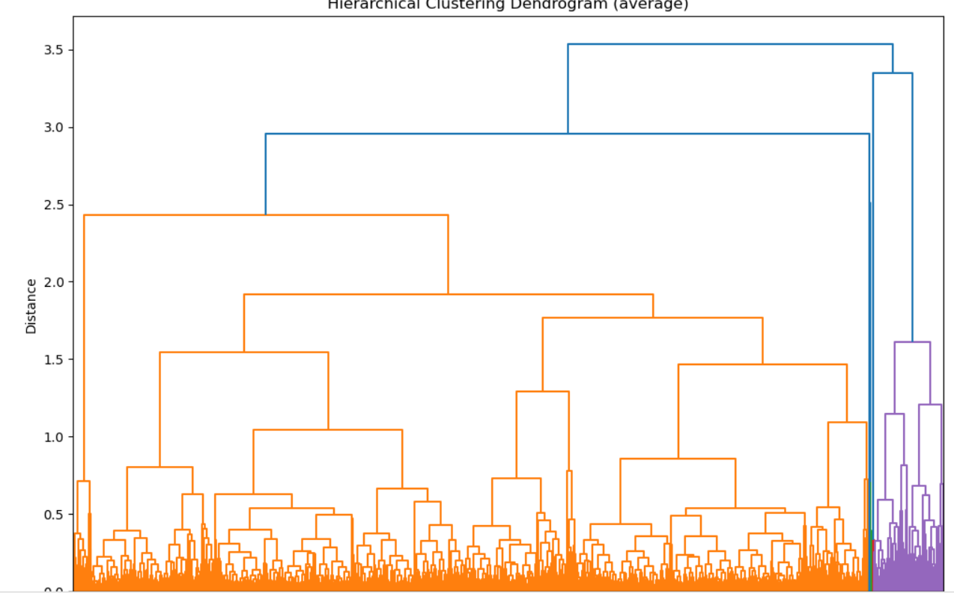
Dendrogram of Average Hierarchical Clustering

Slide 19
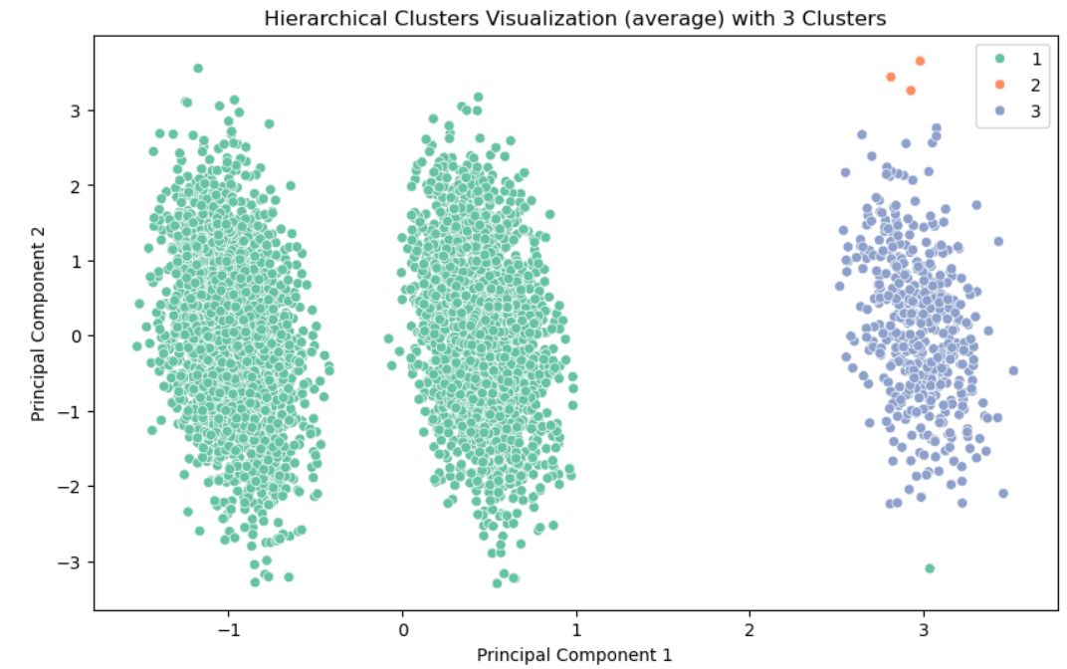
Hierarchical Clusters Visualization with 3 Clusters

Slide 20
Hierarchical Clustering with Average Linkage was chosen for model building and evaluation to effectively group patients based on symptoms for emergency triage.
Feature Selection: 18 features were selected for analysis.
Scaling and Normalization: Standardization of data to ensure fair distance measurements.
Hierarchical Clustering (Average Linkage): Groups similar data points by minimizing the average distance between clusters.
Principal Component Analysis (PCA) was applied to reduce dimensions and visualize clusters. The plot shows three distinct clusters.
The Hierarchical Clustering model successfully identified three distinct clusters.This can be leveraged for effective patient triage, prioritizing emergency care based on symptom severity.

Slide 21
MODEL DEPLOYMENT
Streamlit Framework: The model was deployed using Streamlit, an interactive web-based application for real-time patient triage.
Real-time Input Handling: Users can input patient symptoms and receive cluster-based predictions.
User-friendly Interface: Visual representation of clusters and insights for effective decision-making.

Slide 22
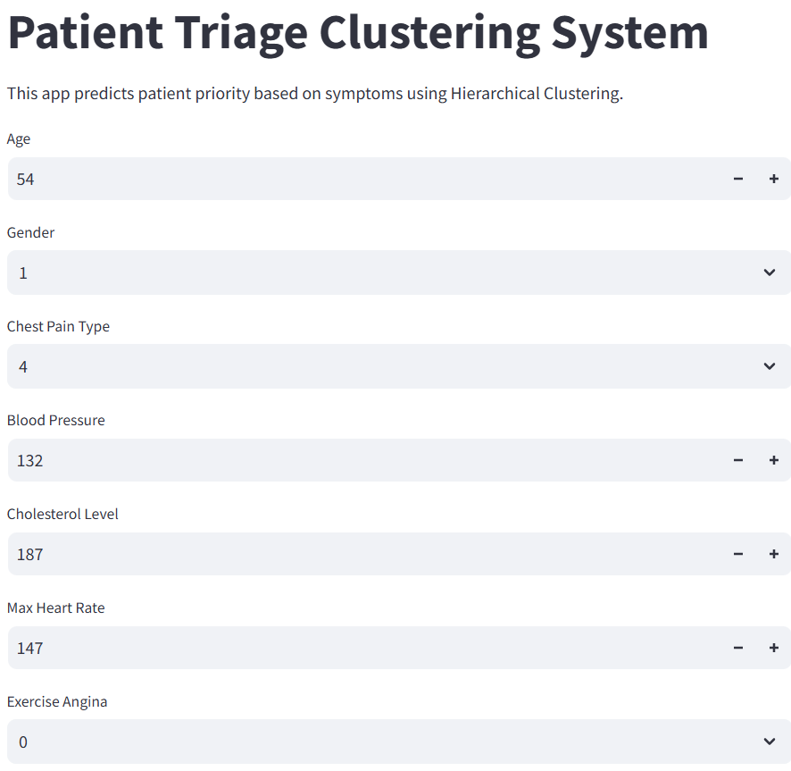
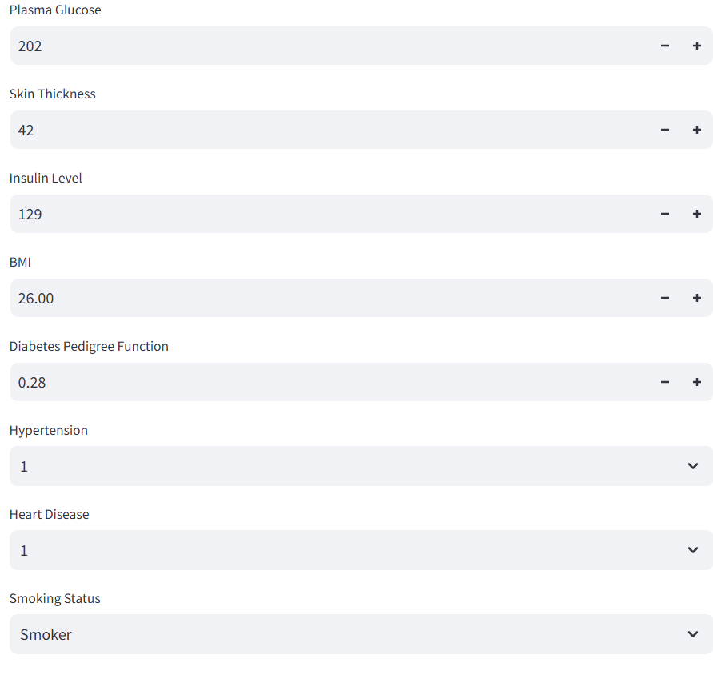
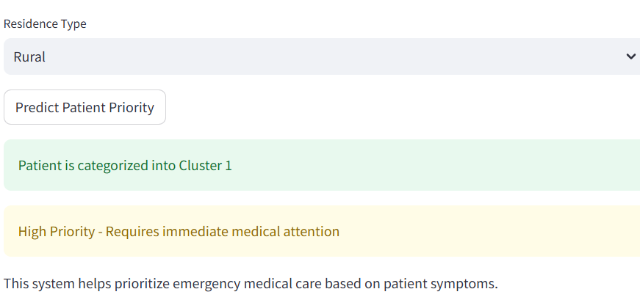

Slide 23
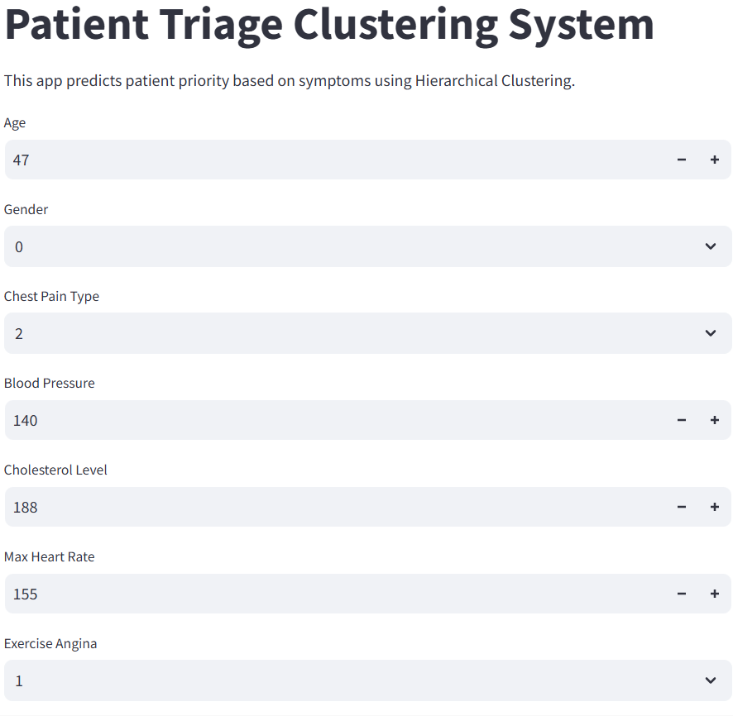
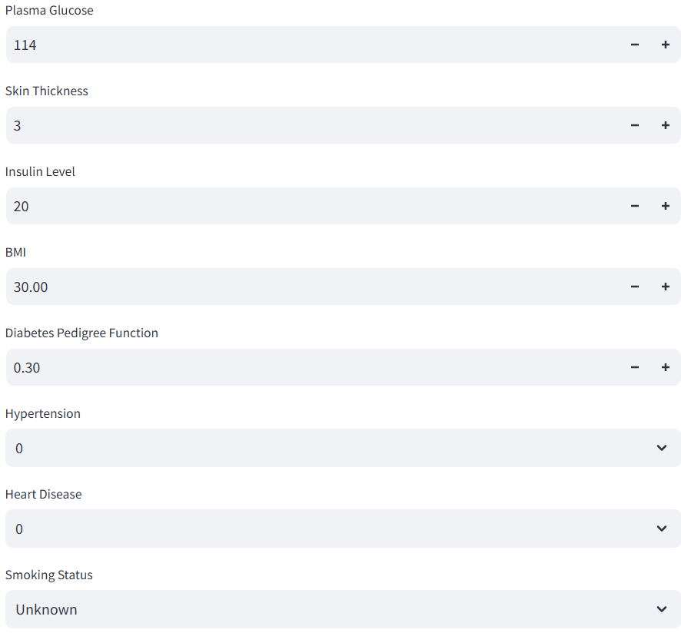
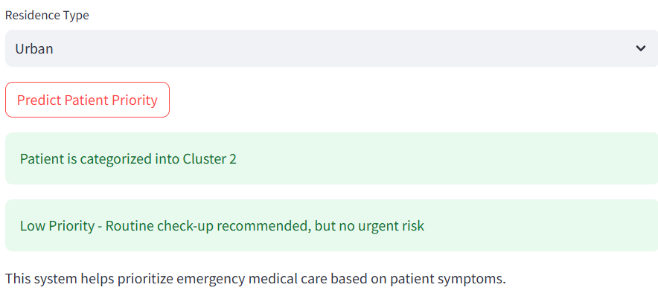

Slide 24
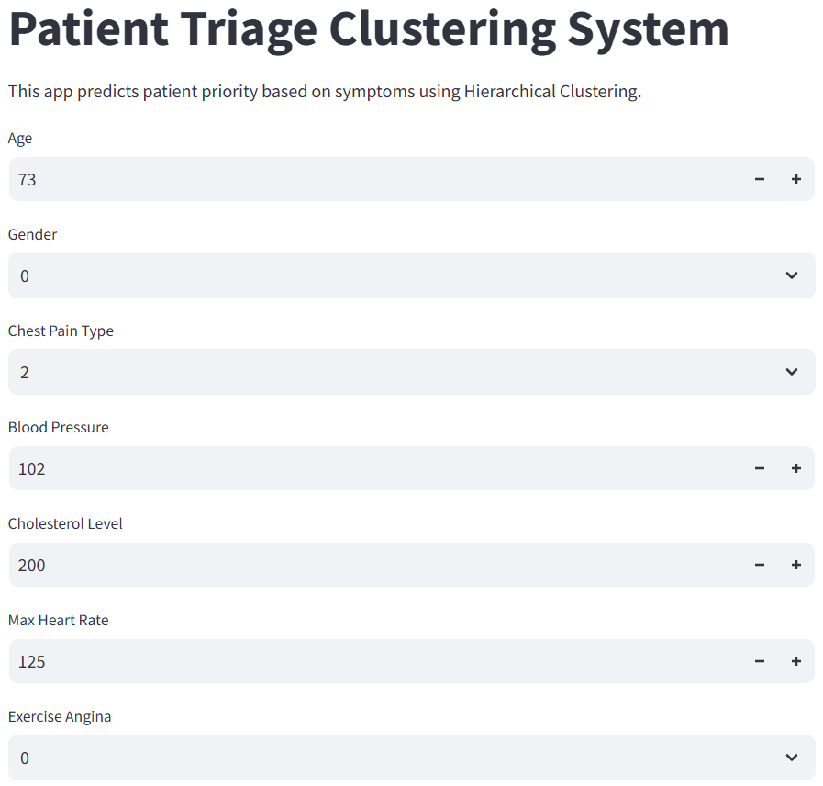
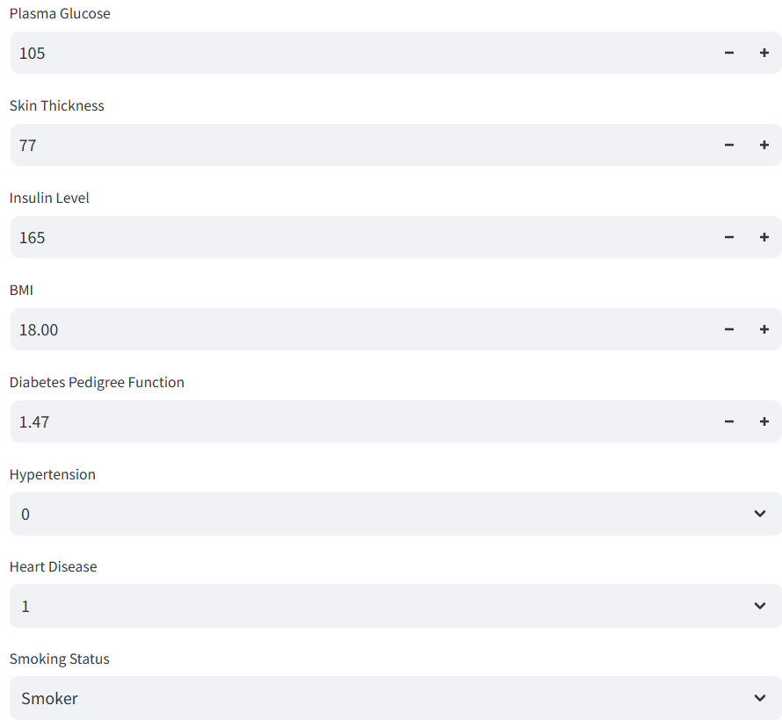
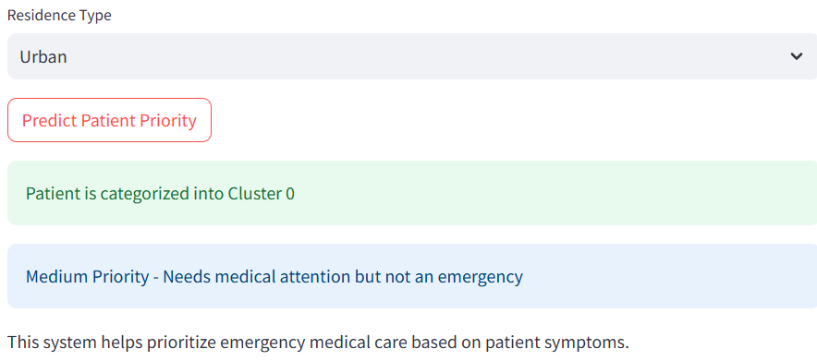

Slide 25
CHALLEGES FACED DURING THE PROJECT
Data Challenges:
Handling missing values
Model Challenges:
Ensuring clusters accurately represent illness severity.
Selecting the optimal clustering algorithm for best patient classification.
Deployment Challenges:
Optimizing Streamlit performance for smooth real-time predictions.
Ensuring the model works well with new, unseen patient data.

Slide 26
OVERCAME THE CHALLENGES
Data Pre-processing & Cleaning:
Standardized symptom names across datasets.
Filled missing values using imputation techniques.
Model Optimization:
Compared K-Means, DBSCAN, and Hierarchical Clustering, selecting Hierarchical for better separation.
Tuned hyperparameters to improve cluster cohesion and separation.
Deployment Solutions:
Optimized Streamlit UI for a smooth user experience.Ensured model generalizes well to new patient data.

Slide 27
CONCLUSION
Successfully developed a Patient Triage Clustering System to prioritize emergency cases. Hierarchical Clustering with Average Linkage model was the best model, categorizing patients into High, Medium, and Low Priority groups. By leveraging unsupervised learning, the model enables data-driven decision-making, reducing response times and improving patient outcomes.
Deployed using Streamlit, allowing real-time triage classification based on symptoms.This system can help medical professionals make faster and more informed decisions in emergency situations.Future improvements include enhancing model accuracy, integrating real-time vitals, and expanding the dataset for better predictions.

Slide 28
Thank you

